Slide 1

Water analysis device
Potaiotabetazeta

Slide 2
ph measurement fe concentration
Colour Sensing
5% solution
No need of reference sample
Colour Sensing
5% solution
Reference sample is needed

Slide 3
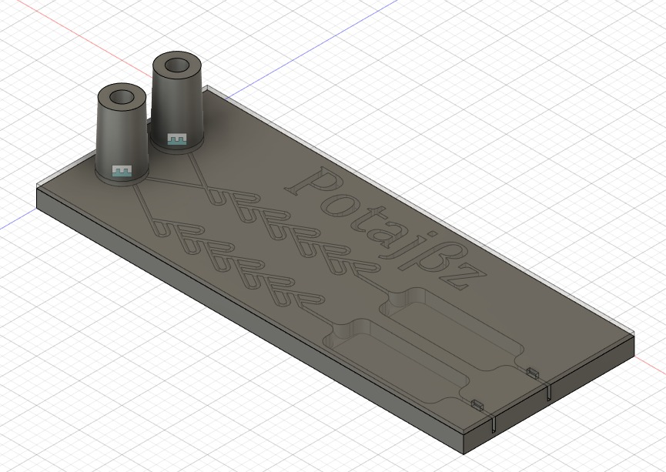
THE DEVICE
Two syringe pumps
Tesla Mixer to mix reagents
Dummy Tesla mixer for impedance matching
Mixing Well
Reference Well
Two vents for air expulsion
Two drain holes

Slide 4
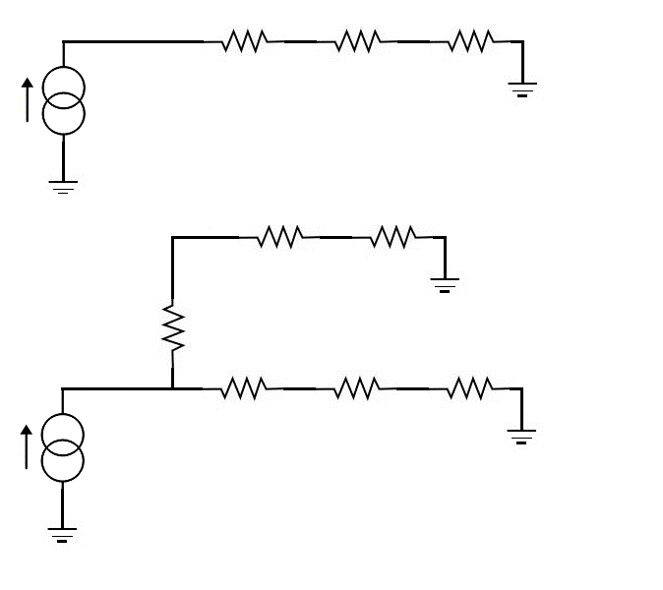



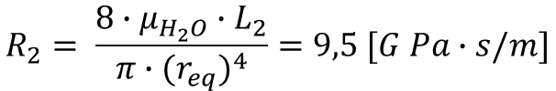











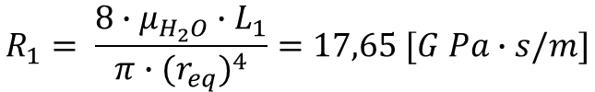






Equivalent circuit
$$h=350 um$$
w$=350 um$
$$μ_{H_{2}O}= {10}^{−3} [Pa/s]$$
$$R_{1}$$
$$R_{T}$$
$R_{w}+$ $R_{2}$
$$L_{1}=6.5 mm$$
$$L_{T}=17. 6mm$$
$$L_{2}=17. 6mm$$
$$Q_{a}$$
$$r_{eq}= \frac{2∙h∙w}{2∙(h+w)}=175 [um]$$
$$R_{T}$$
$R_{w}+$ $R_{2}$
$$R_{1}= \frac{8∙μ_{H_{2}O}∙L_{1}}{π∙{(r_{eq})}^{4}}=17,65 [G Pa∙s/m]$$
$$R_{1}$$
$$R_{T}= \frac{8∙μ_{H_{2}O}∙L_{T}}{π∙{(r_{eq})}^{4}}∙1,5=71,7 [G Pa∙s/m]$$
$$R_{1}$$
$$R_{T}$$
$R_{w}+$ $R_{2}$
$$R_{2}= \frac{8∙μ_{H_{2}O}∙L_{2}}{π∙{(r_{eq})}^{4}}=9,5 [G Pa∙s/m]$$
$$Q_{a}$$
$$R_{w}=negligible$$

Slide 5


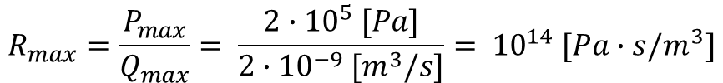



Specs and parameters check
$$Q_{max}=2 [ul/s]$$
$$P_{max} =2\left[atm\right]=2∙{10}^{5} [Pa]$$
$$R_{max}=\frac{P_{max}}{Q_{max}}= \frac{2∙{10}^{5} [Pa]}{2∙{10}^{−9} [m^{3}/s]}= {10}^{14} [Pa∙s/m^{3}]$$
$$R_{r}≅R_{1}+R_{T}+R_{2}=17,65+71,7+9,5\left[G Pa∙\frac{s}{m}\right]=98,8\left[G Pa∙\frac{s}{m}\right]$$
$$R_{a}≅R_{r}/2≅\frac{R_{1}+R_{T}+R_{2}}{2}=\frac{17,65+71,7+9,5}{2} \left[G Pa∙\frac{s}{m}\right]=49,4\left[G Pa∙\frac{s}{m}\right]$$
$$R_{a}≅R_{r}/2 ≪{ R}_{max}$$
$Q_{r}=5\%$ $∙ Q_{a}/2$
$$R_{r} ≪{ R}_{max}$$

